Slide 1
RFID Smart Attendance system with google sheet & door unlocking system
SUBMITTED BY
Prabal Chakraborty (10800320038)
Anchal kumari (10800320042)
Agnisis Dutta (10800320053)
Faraz Ahmed Khan (10800320055)
DEPT-ECE
SEM-6TH SEM
YEAR-3RD
^{PAPER NAME-MINI PROJECT}
^{PAPER CODE-EC-681}
^{BATCH-B1}
^{GROUP-02}

Slide 2
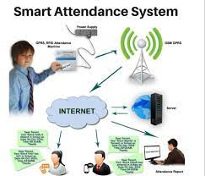
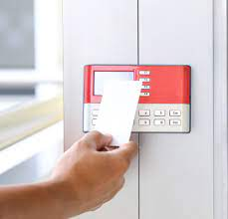

INTRODUCTION:-
The RFID Attendance System with Google Sheet Integration and Door Unlocking System combines advanced RFID technology, cloud-based data management, and access control mechanisms to create an efficient and secure solution for attendance tracking and door access in various settings. This system addresses the challenges associated with traditional attendance management methods and enhances the overall security and convenience of access control systems. Attendance tracking is a crucial process in many environments, including educational institutions, workplaces, and research facilities. Traditional methods, such as manual sign-in sheets or barcode scanning, can be time-consuming, prone to errors, and lack real-time data updates. The RFID Attendance System offers a more accurate and automated approach by leveraging RFID technology.

Slide 3
MOTIVATION
Accuracy and Efficiency:
Real-time Data Updates:
Streamlined Data Management:.
Enhanced Security:
Scalability and Flexibility:
Cost-effectiveness:

Slide 4
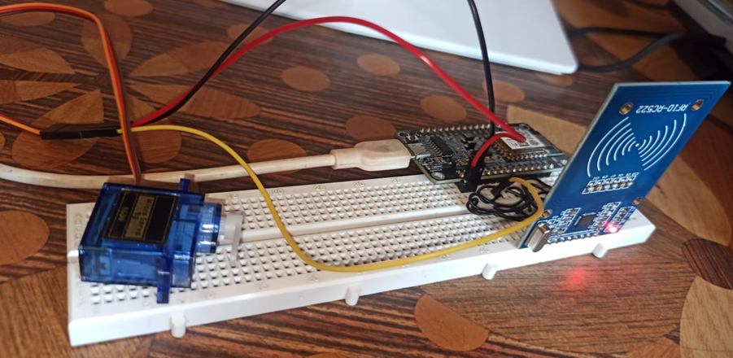
COMPONENTS USED:-
Node MCU ESP8266
RC552 RFID reader
RFID tags
Breadboard
Servo motor
Jumper wire
Connecting wires

Slide 5
FLOW OF PROJECT:-
STORE DATA TO RFID CARDS
SEND DATA TO NODE MCU
ASSEMBLE HARDWARE SYSTEM
DATA FROM GOOGLE SHEET DISPLAYED ON WEB
NODE MCU SENDS DATA TO GOOGLE SHEET

Slide 6
PIN CONFIG:-
NODE MCU PINS | RFID PINS | SERIAL DATA COMMUNICATION
D1 | RST
D2 | SDK/SS
D7 | MOSI
D6 | MISO
D5 | SCK
NODE MCU | SERVO MOTOR
D8 | ORANGE
VIN 3 V | RED
GND | BROWN

Slide 7
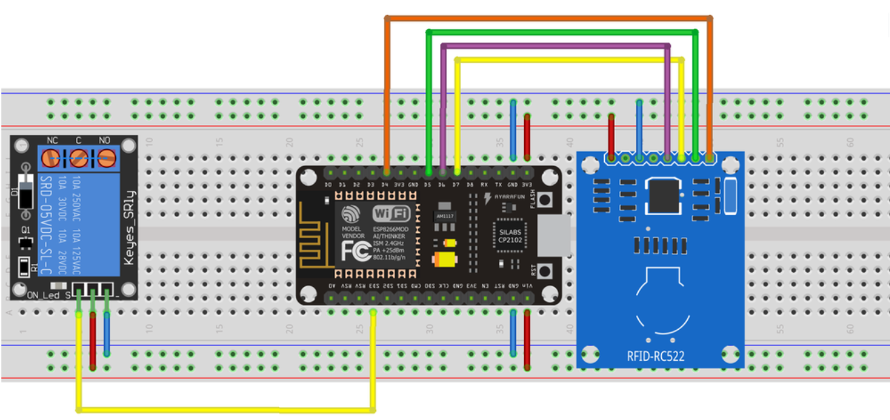
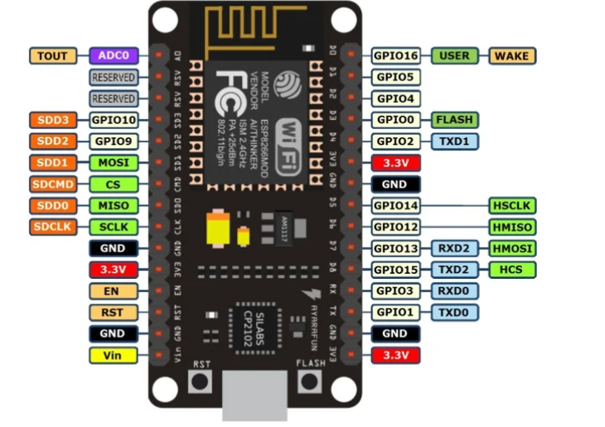
CIRCUIT DIAGRAM:-

Slide 8
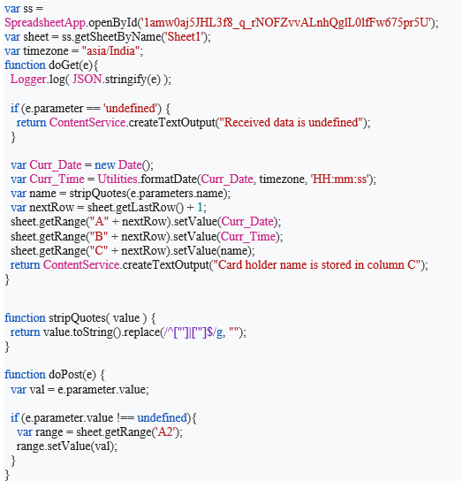
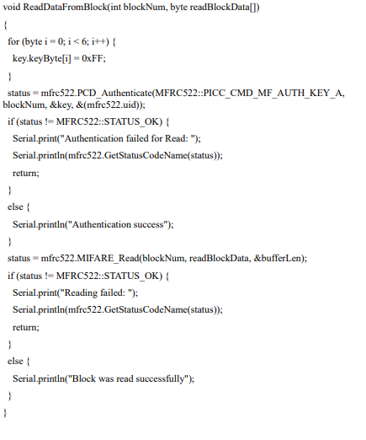
CODES:-

Slide 9
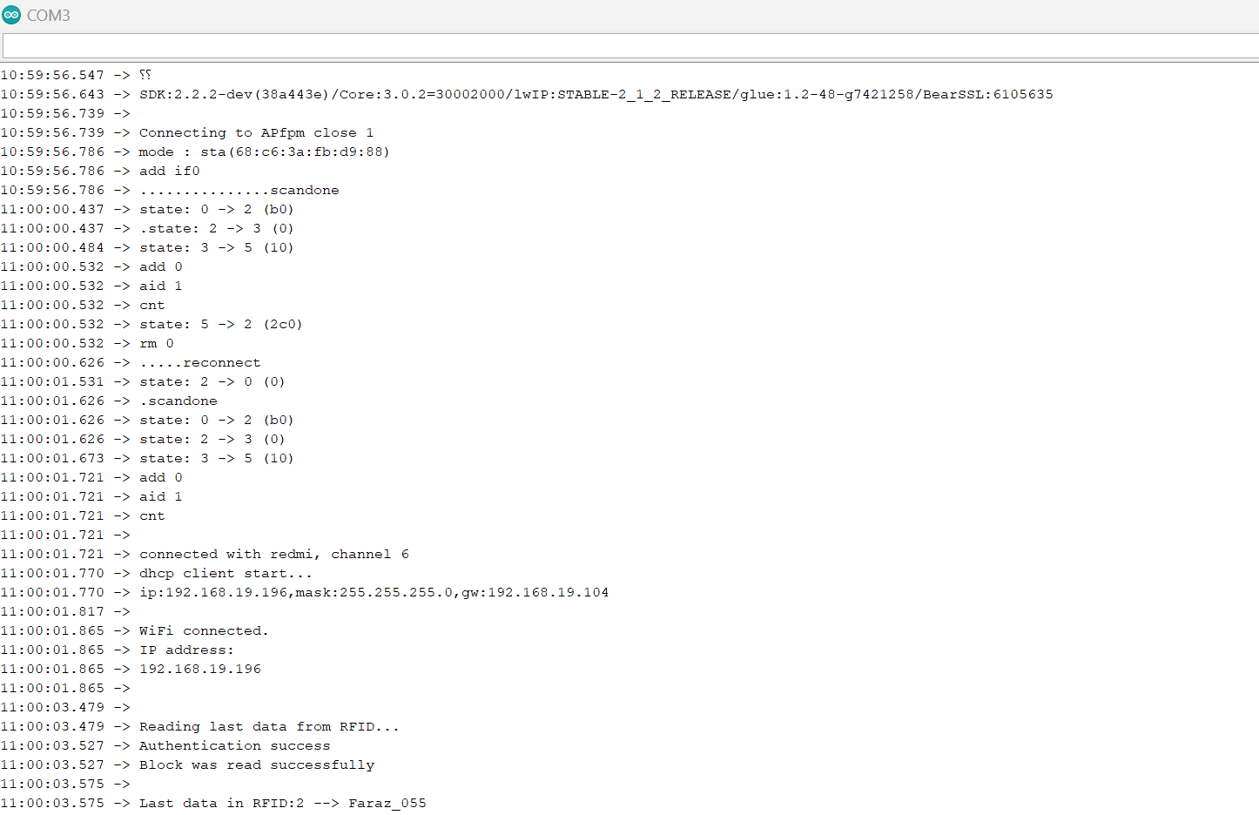
SERIAL MONIOTOR OUTPUT

Slide 10
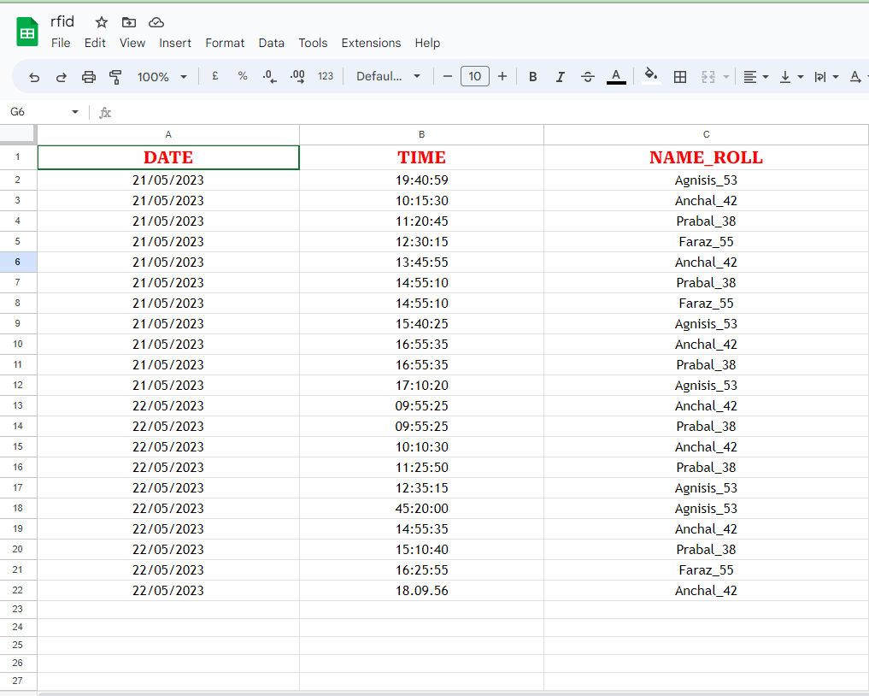
GOOGLE SHEET:-

Slide 11

LIMITATIONS:-
This RFID system is for small case application purpose .
Data stored in google sheet provide limited facility.
Authentication system can be made better using other Auth Service .
NodeMcu can handle limited operations to include lcd or buzzer we need more io ports .
An Adruino uno is much more efficient but costly.
RFID scanner can be used of higher frequency to increase acceptance of long range RFID tags/cards.

Slide 12
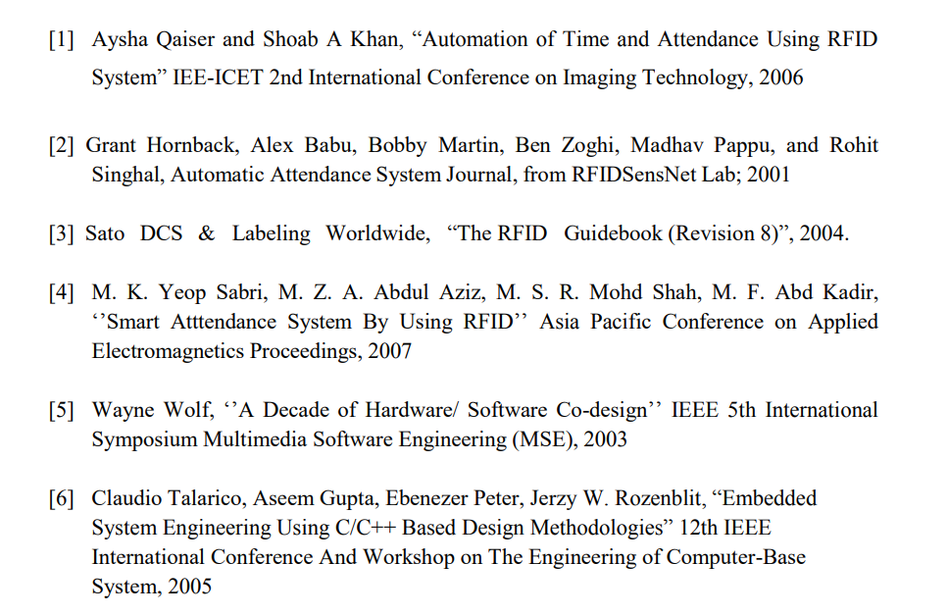
REFERENCES:-

Slide 13
FUTURE SCOPE OF IMPROVEMENT:-
1.Include Biometric sensor for Fingerprint authentication.
2.Include camera module for face recognition.
3.Data can be used for monitoring for specific data analysis work.
4.Realtime facial recognition can be used to track students’ engagement time in the class.
5.More no of validation can be added to make the system more secure for admin Pannel.

Slide 14
Conclusion:-
The RFID attendance system implemented with NodeMCU and servo motor for door unlocking provides an efficient and secure solution for attendance management and access control. This system utilizes RFID technology to accurately identify individuals, eliminating manual attendance tracking and reducing the risk of unauthorized access. The integration of the NodeMCU microcontroller board enables seamless connectivity and real-time data processing. The servo motor serves as a reliable mechanism for unlocking the door, responding promptly to valid RFID card scans. This system improves efficiency, minimizes errors, enhances security, and ensures accountability. It is a comprehensive solution for organizations seeking to streamline attendance management and enhance access control measures

